Slide 1
NLP

Slide 2
Introduction to NLP
Transition-based Dependency Parsing

Slide 3
Transition-Based Parsing
Similar to shift-reduce
Produces a single (projective) tree
Data structures
Stack of partially processed (unattached) words
Input buffer
Set of dependency arcs
Attach the word on the top of the stack to the word at the current position in the buffer (or in the other direction)

Slide 4
Transition-Based Parsing
Initial configuration
Stack (including the root token w0)
Buffer (sentence)
Arcs (empty)
Goal configuration
Stack (empty)
Buffer (empty)
Arcs (complete tree)

Slide 5
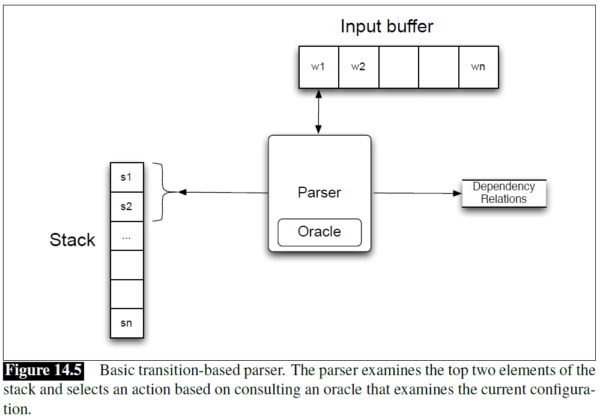
Example
“Book me the morning flight”
[Example from Jurafsky and Martin]

Slide 6
MaltParser (Nivre 2008)
The reduce operations combine an element from the stack and one from the buffer
Arc-standard parser
The actions are shift, left-arc, right-arc
Arc-eager parser
The actions are shift, reduce, left-arc, right-arc

Slide 7
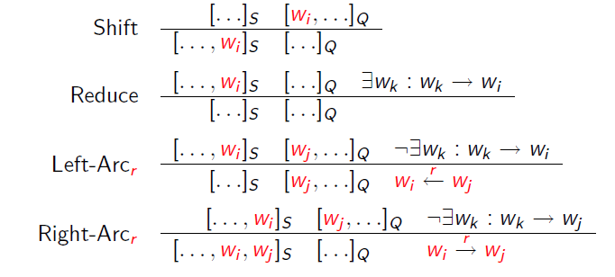
(Arc-Eager) MaltParser Actions
[Example from Nivre and Kuebler]

Slide 8
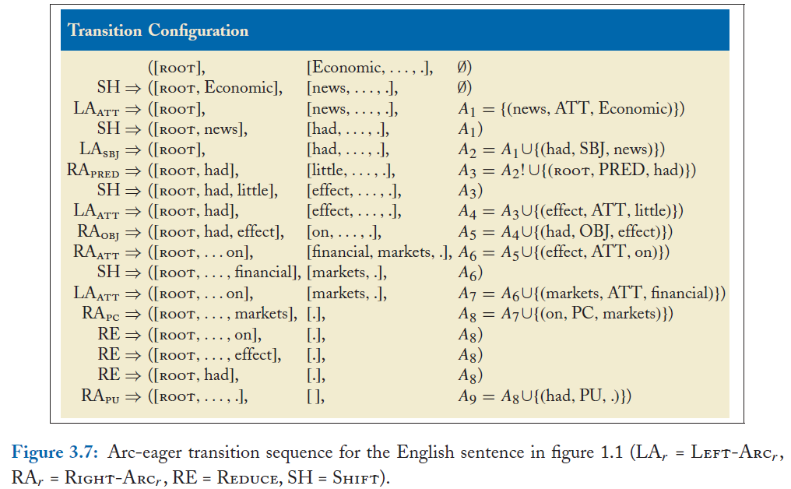
[Example from Kuebler, McDonald, Nivre]

Slide 9
Example
Example: “People want to be free”
[ROOT] [People, want, to, be, free] Ø
Shift [ROOT, People] [want, to, be, free]
LA_{nsubj} [ROOT] [want, to, be, free] A₁ = {nsubj(want, people)}
RA_{root} [ROOT, want] [to, be, free] A₂ = A₁ ∪ {root(ROOT, want)}
Characteristics
Approximate the oracle with a classifier: o(c) = argmax_{t} w.f(c,t)
There is no search in the greedy version (although beam search also works)
The final list of arcs is returned as the dependency tree
Trained on a dependency treebank
Very fast method

Slide 10
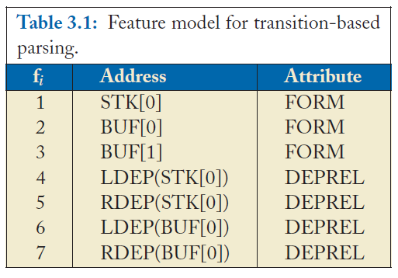
Feature Model
[Example from Kuebler, McDonald, Nivre]

Slide 11
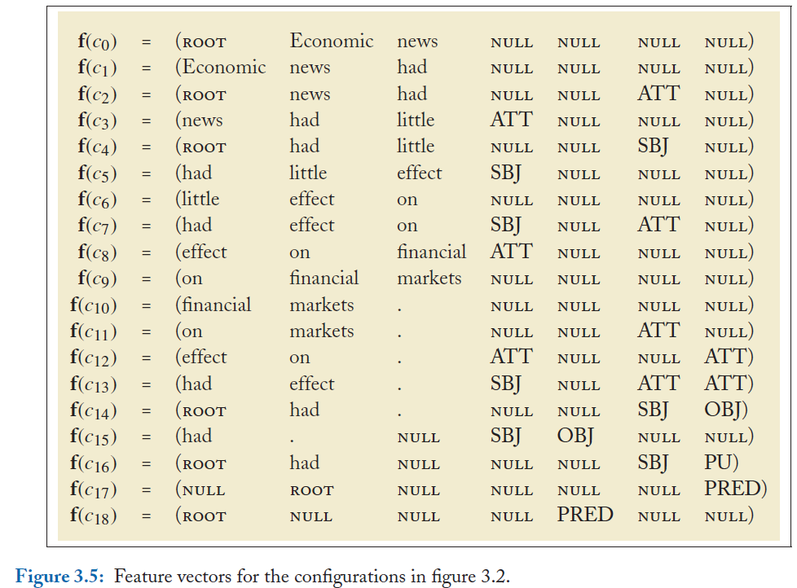
Feature Vectors
[Example from Kuebler, McDonald, Nivre]

Slide 15
Complexity
Arc-eager is O(n³) – like Eisner
Arc-standard is O(n⁵)

Slide 16
NLP

